Slide 1
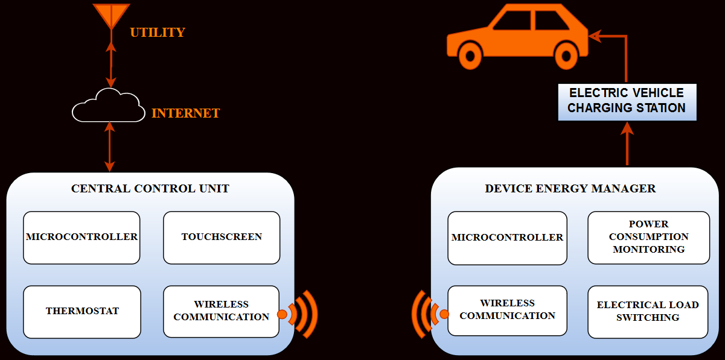
MODEL PICTURES
HOME ENERGY MANAGEMENT SYSTEM
(HEMS)
GRAPHS
GRAPHS
WITHOUT HEMS
WITH HEMS

